Slide 1
RoomScape
Team: CS Grand Order

Slide 2
The Concept
Implement the “Smart” household using various machine learning and IOT techniques.
Provides personalized user experience based on a user’s smart devices, sensors, and the interactions between them.
E.g: Automated lighting that automatically responds to a user passing through a door, while also turning off excess lights to save energy.

Slide 3
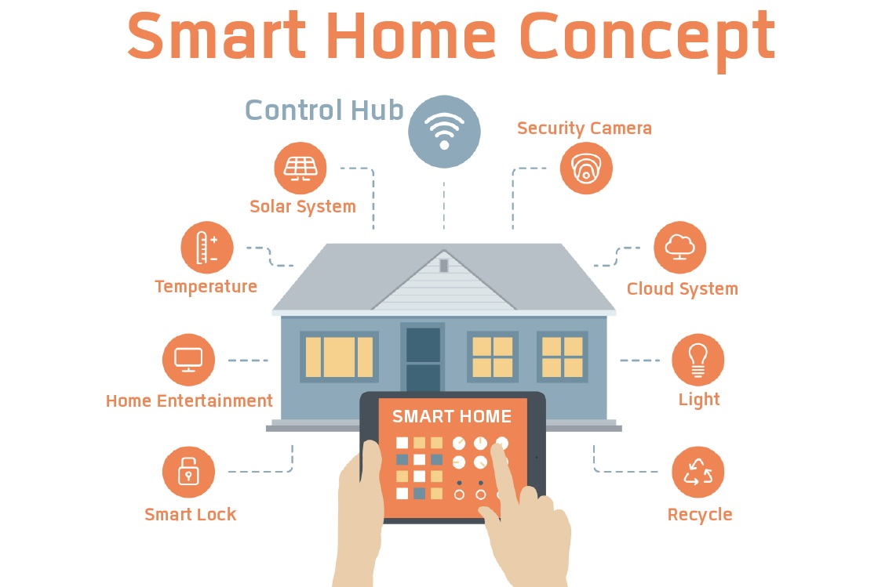

Slide 4

The Difference

Slide 5
The Difference
Our Goal is:
An automated environment specified for each individual user.
Makes educated guesses that reflect the user’s patterns.
Enhance user experience, never controls it.

Slide 6
The Grid
Create a Grid Map based on the floor plan of the house.
Need to Specify:
Different rooms
Floors
Sensors/Devices
Rooms can be fully mapped for additional functionality.

Slide 7
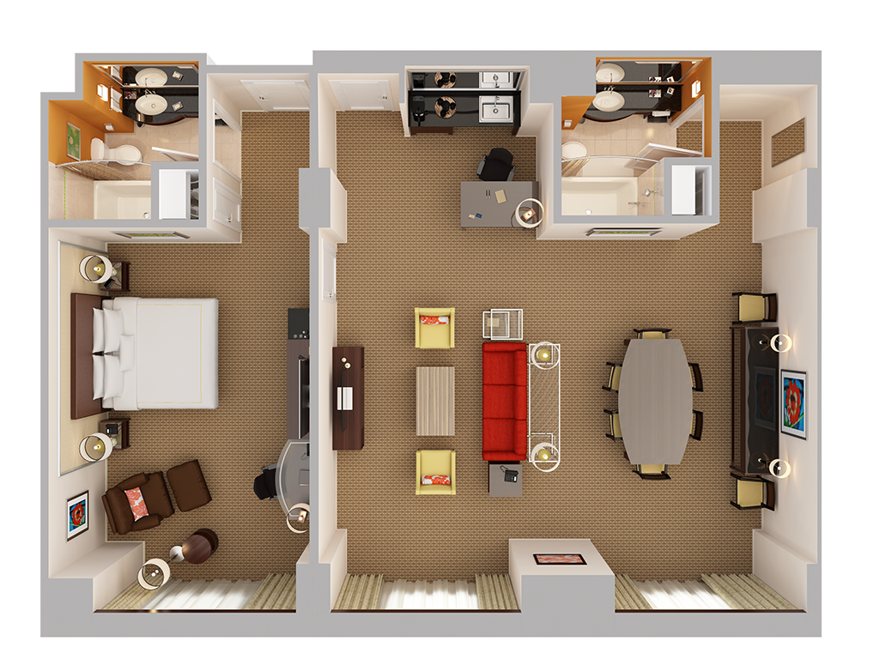
The Grid

Slide 8
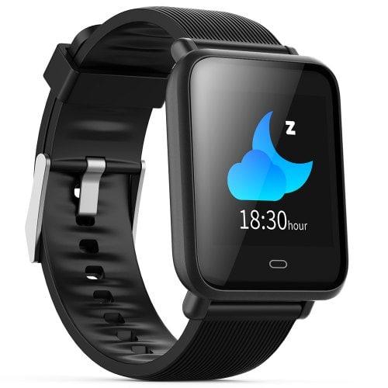
Smart Sync Devices
Connect to smart watch to keep track of heart beat / body temperature.
Control smart devices like tvs, sockets, coffee Makers, etc.
Additional features:
  Temperature control
  Light/LED control
  Speaker control
  Smart Socket Control
  Atmospheric Presets
  Smart Generated Atmosphere.

Slide 9
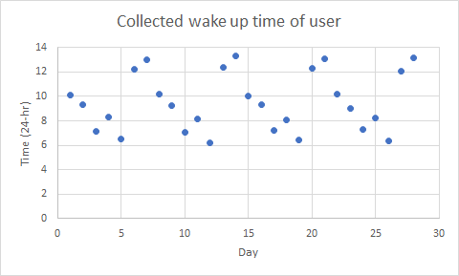
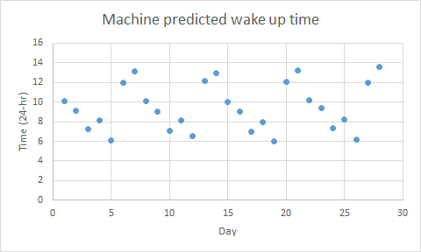
Data Collection from Device
Actively learning more about the user to improve daily life.
Using wake up time to :
Open blinds around the house
Play some morning music the user likes
Auto make coffee.
Notes:
Explain how the validation of data will be useful for the device

Slide 10
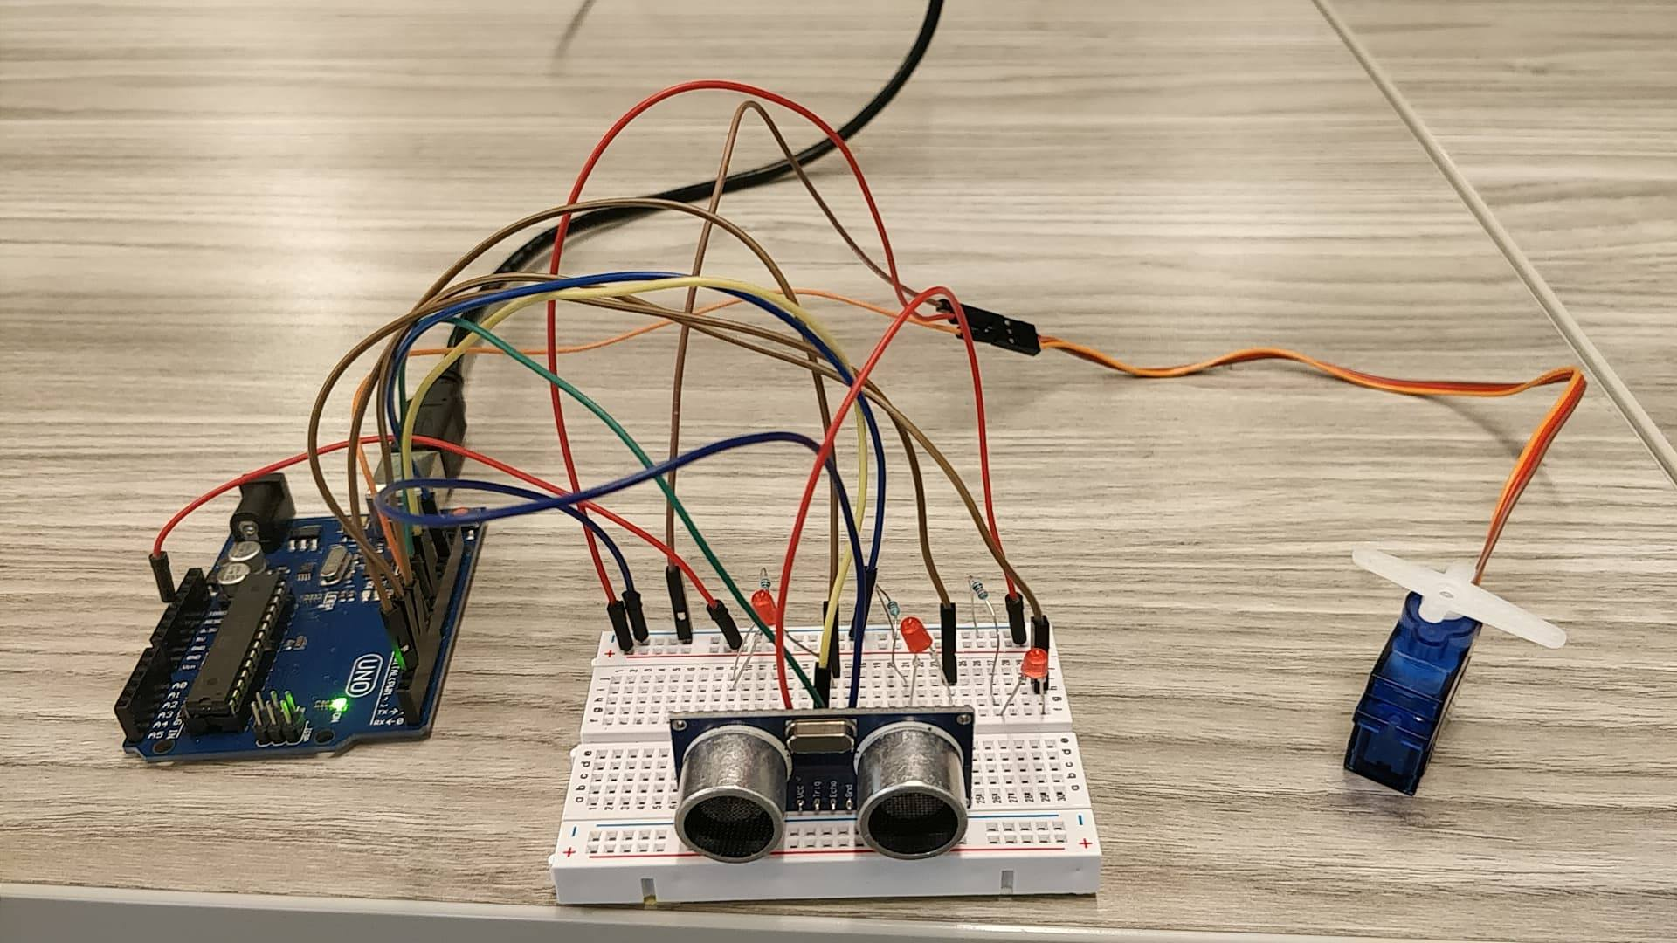
Our Prototype
Microcontroller or GPU
Sensor System
Blinds

Slide 11


Slide 12
Future Ideas
Voice interaction with Alexa/Google Home
A security system to log suspicious activity for the user
Other types of sensors to improve and add more functionality

Slide 13
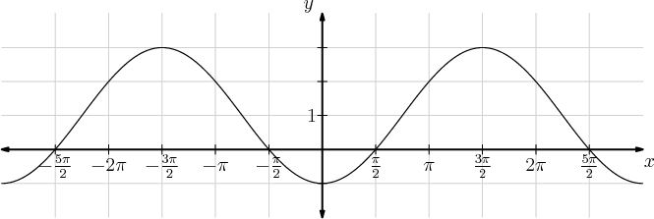
The Use Case with Machine Learning
Be able to predict user waking and sleep times
The graph, looks very similar to a sine or cosine graph
Use case of over-fitting the curve
Gives better predictions

